Slide 1

Team Promotion Alarm Clock
Penbo Simplicity

Slide 2

Agenda
Approach
Project Management
Technical
Architecture
Testing
Demo

Slide 3

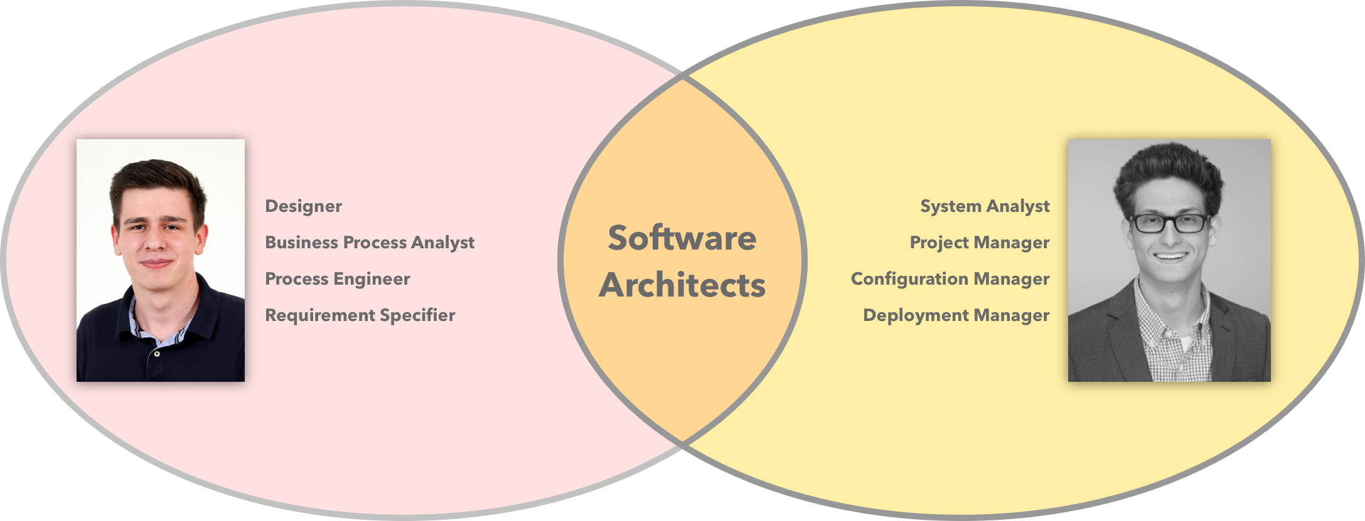
Team

Slide 4

Approach

Slide 5

Approach - Vision
Real – Time
Simple
Assistance
Reliable
Smart

Slide 6

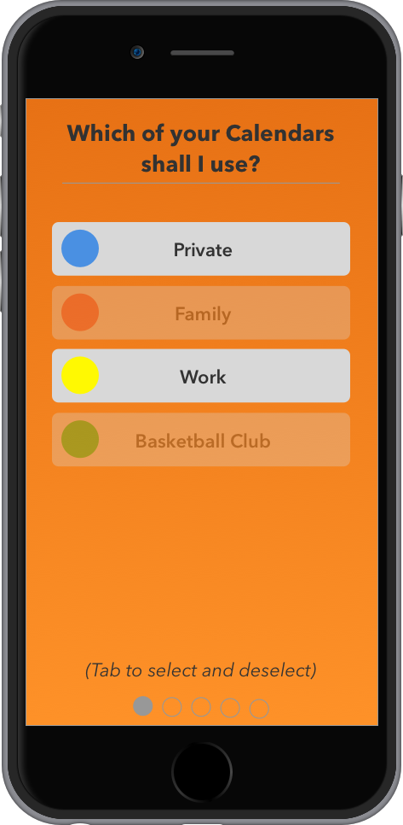
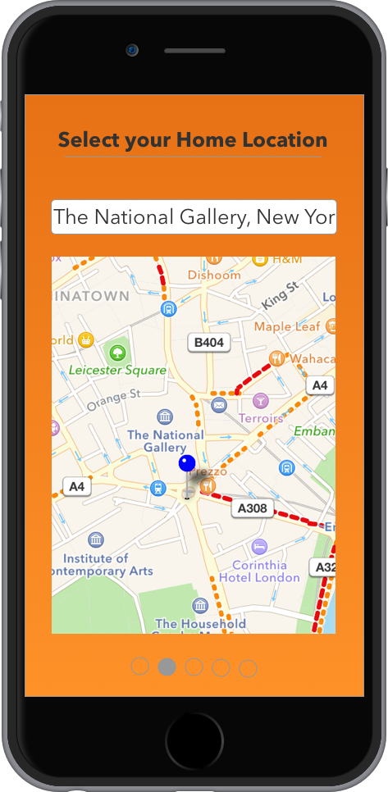
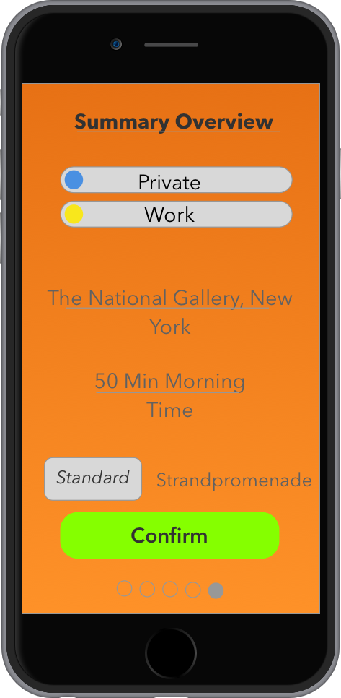
Approach – Mock Ups

Slide 7

Project Management

Slide 8
Project Management – Methodology
Why not Waterfall?

Slide 9
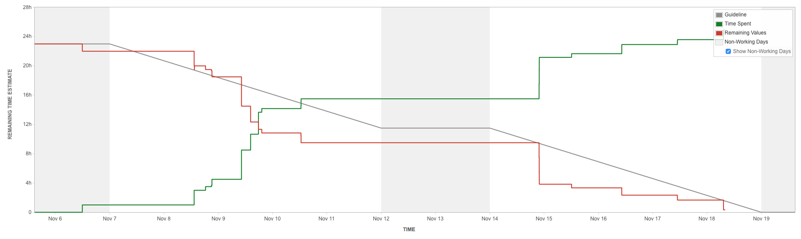
Project Management – Scrum Tool

Slide 10
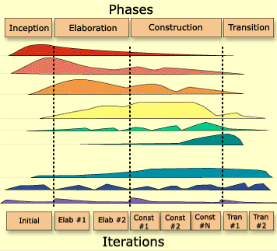
Project Management – Rational Unified Process
Long Term Planning
Disciplines
Business Modelling
Requirements
Analysis & Design
Implementation
Test
Deployment
Configuration &
Change Management
Environment
Project Management

Slide 11
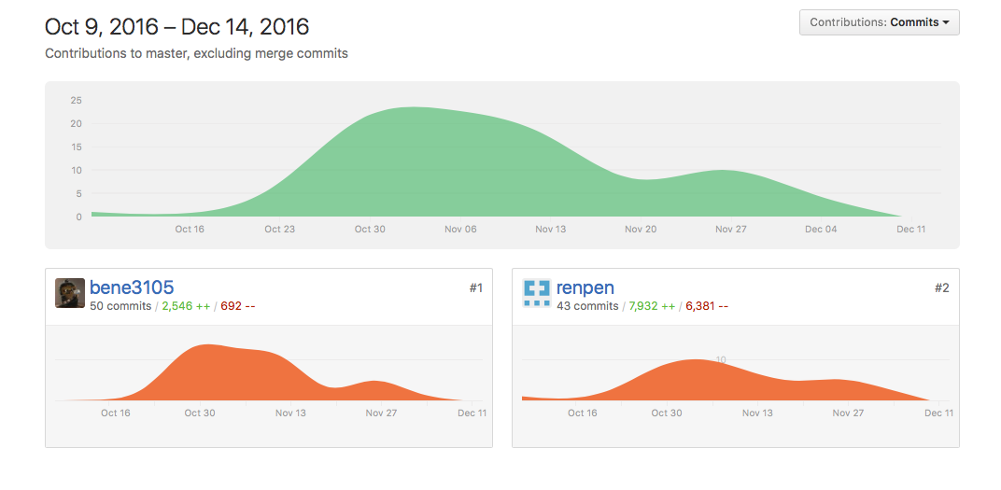

Project Management – Version Control

Slide 12
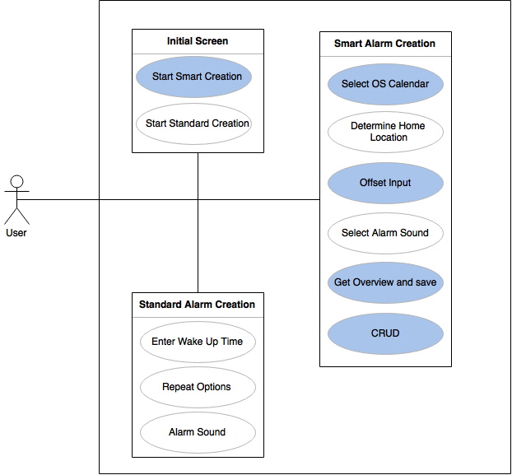
Project Management – Overall Use Case Diagram

Slide 13

Technical Environment

Slide 14
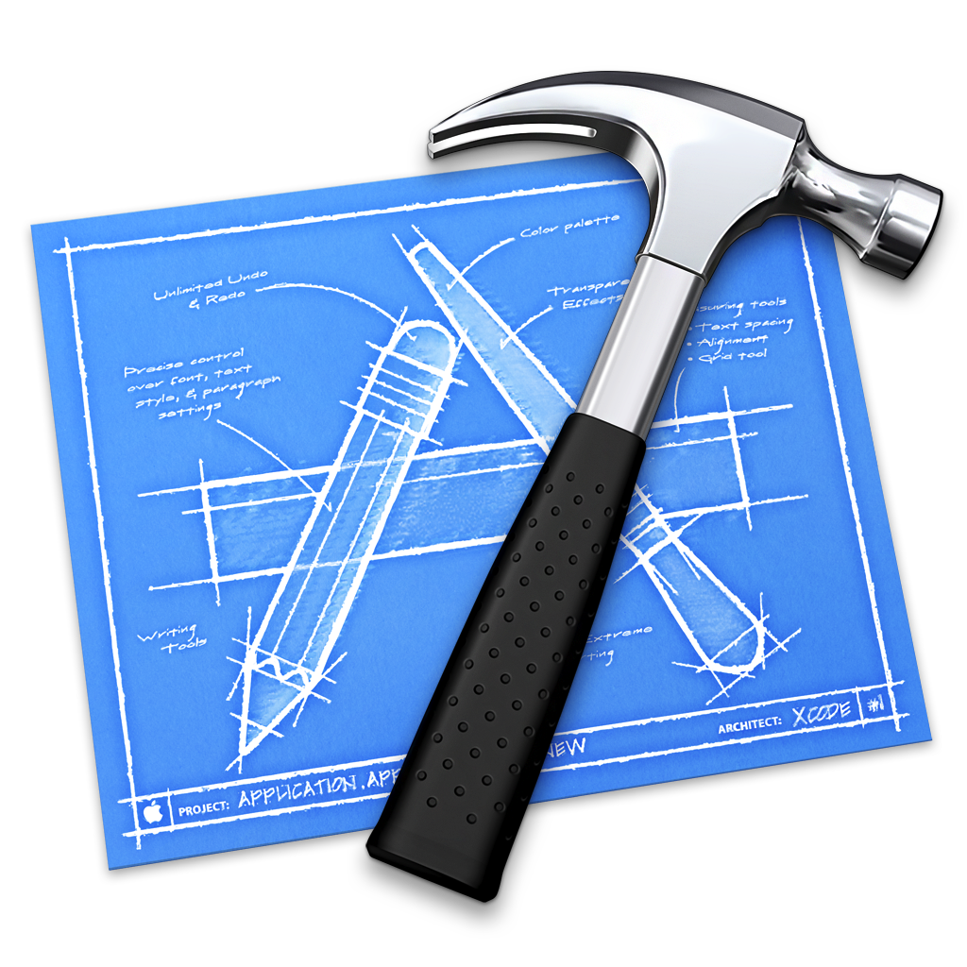

Technical Environment – iOS

Slide 15
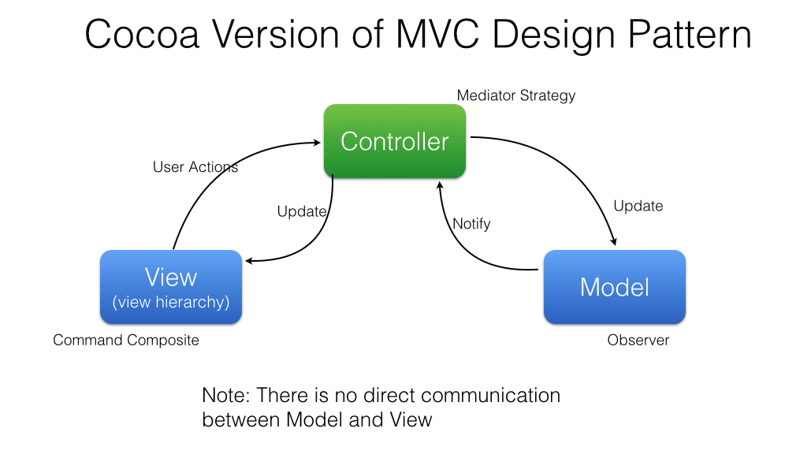
Technical Environment – MVC in Context of Swift

Slide 16

Archtitecture

Slide 17
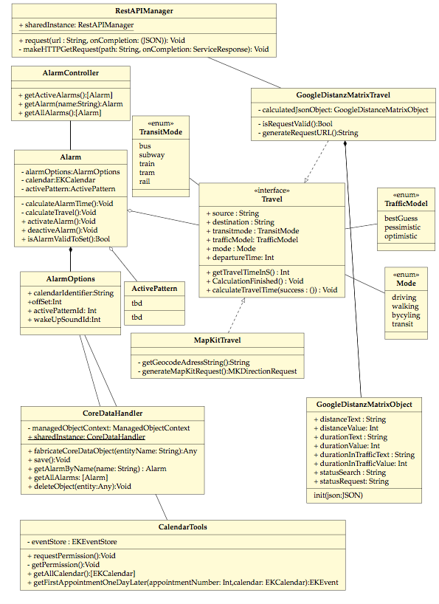
Architecture – Class Diagram

Slide 18
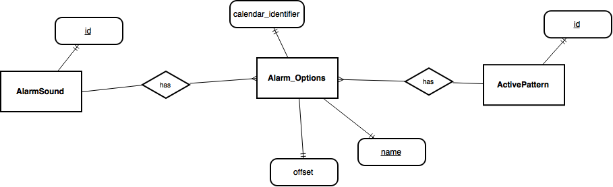
Architecture – Entity Relationship Model

Slide 19

Testing Infrastructure

Slide 20
Testing Infrastructure – Xcode UI Testing

Slide 21
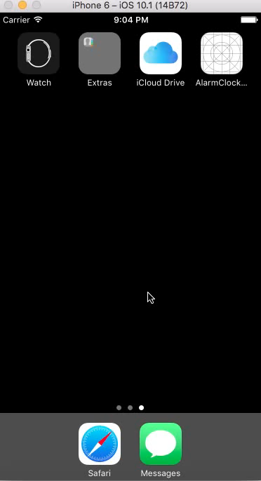

Slide 22

Demo

Slide 23
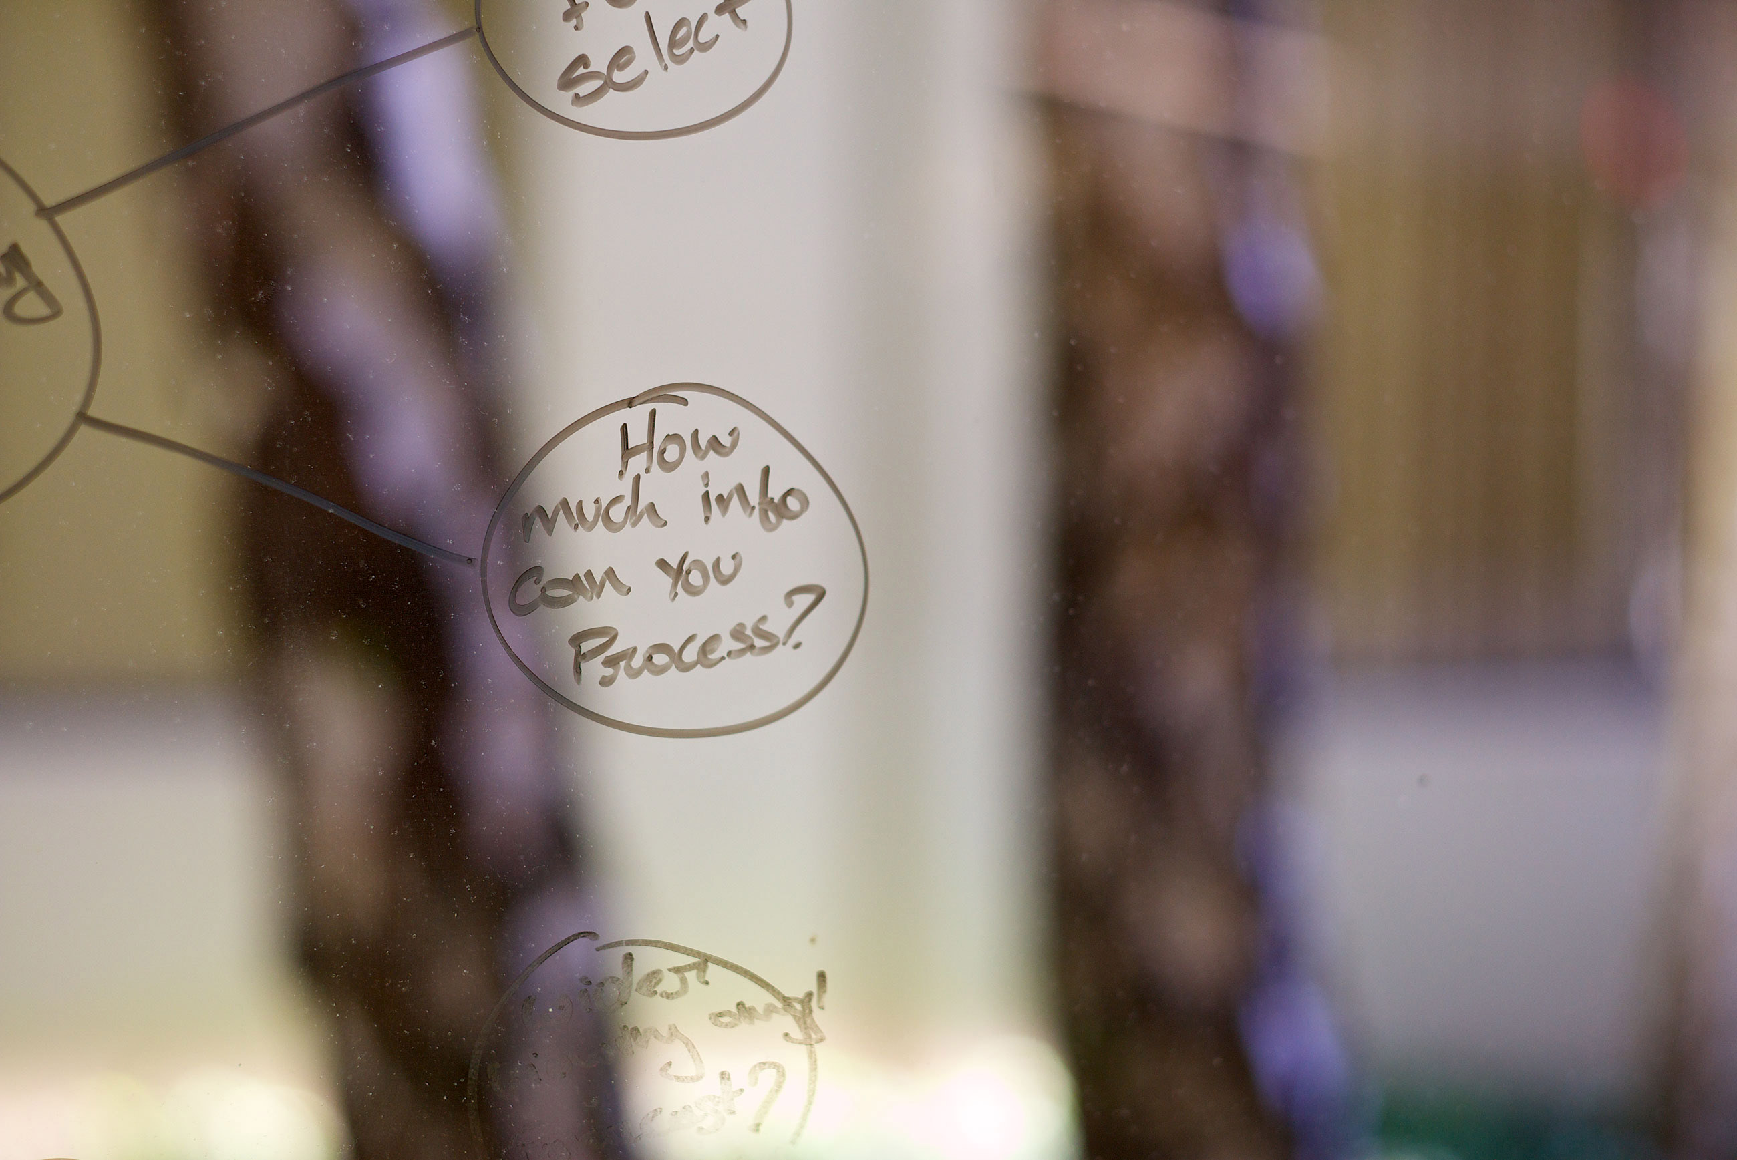
Questions

